Slide 1


Finding the optimum spot for the Halewijn Award Ceremony in Haarlem, the Netherlands
Applied Data Science Capstone Project by IBM/Coursera
Kees korver, data scientist in spe
December 11, 2019

Slide 2
INDEX
Introduction
Data
Methodology
Exploratory Data Analysis
Results & Discussion
Conclusion

Slide 3
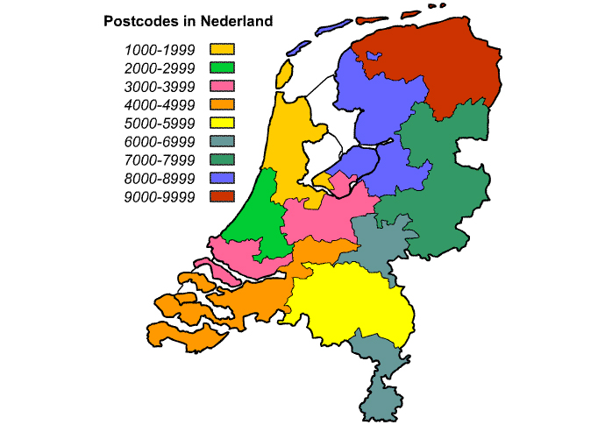
introduction
Halewijn Prijs a Dutch national award
intended for literary talent that deserves extra interest.
Haarlem, the Netherlands. Capital of the province of North Holland, 161,265 inhabitants.
Demands for ideal neighbourhood
* near vicinity of book shops
* ample restaurants present
preferably within walking distance of Central Station
Aim of project
* find an optimal location for the Award Ceremony.
Stakeholders
* Organizing Committee of the Foundation Circle Halewijn * book retailers * literary organizations.
introduction data methodology data analysis results conclusion
Notes:
The Halewijn Prijs is a Dutch national award, intended for literary talent that, based on quality and irresistibility of his or her published work, deserves extra interest. The prize consists of a cash prize and a bronze small statue made by Dick van Wijk.
Recently, it was decided that the yearly Award Ceremony will take place in the city of Haarlem, the Netherlands. Haarlem is capital of the province of North Holland and has 161,265 inhabitants. To attain maximal public attendance, the ideal neighborhood would be in the vicinity of the railway station in order to facilitate traveling by public means in a car-crowded city like Haarlem. Furthermore, to maximize potential book sales, a location should be found that is in the near vicinity of book shops around. Finally, ample restaurants should be present here as well, to accommodate the audience (and the winner and jury members, who will dine together afterwards). The aim of this project is to find an optimal location for the Award Ceremony. The report will be targeted to the organizing committee of the Foundation Circle Halewijn, but could be useful to other stakeholders, such as book retailers and literary organizations.

Slide 4

data
data sources
* Nederlandse Postcodetabel Dutch Postal Code Dictionary in Excel xlsx format * GeoPy Python 3 client for geocoding web services * Foursquare API Location data of book stores and restaurants.
data cleaning
- PO Box
street nm aggregat
Dutch PC (n = 471,781) (Excel©)
Haarlem PC 1 (n = 4257) (Excel©)
Haarlem PC 2 (n = 4123) (panda df)
Haarlem PC 3 (n = 4032) (panda df)
feature selection
* Neighborhood * Street Names * Latitude avg * Longitude avg
unique PC
Haarlem PC 4 (n = 19) (panda df)
missing values
none
data types
Neighborhood: int>object
normalization
relative frequencies
introduction data methodology data analysis results conclusion
Notes:
Gather insight in: * existing neighborhoods of Haarlem, based on the Dutch Postal Code system; * the number of existing bookshops in the various neighborhoods of Haarlem; * the number of restaurants in the neighborhood, if any.
Delineation of neighborhoods will be based on the Dutch Postal Code dictionary.
From the primary Dutch postal codes dataset pd_Dutchpc (n=471781; 46.8Mb), all non-Haarlem records dropped. From resulting dataset (n=4257) PO Box data (all with one geographical location) were discarded, leaving 4123 records. Inspection revealed 10 missing values in the column PostcodeLetters. However, this column, as well as 7 other columns, were not informative with regard to current analysis, so they were dropped. Then street names aggregated into unique postal codes: 4032 entries remained. Further segmentation into 19 different Neighborhoods (“Wijk”) (based on the Postal Code (“Postcodenummer”). Features selected: Neighborhood, Street Names, averaged latitudes and longitudes. Coordinates of book shops & restaurants added to the dataframe.
Inspection of definite data: no missing values. One data format was changed (column “Wijk”) from integer to object to enable labelling on map. Data finally normalized to yield relative frequencies.

Slide 5
methodology
Identify areas of Haarlem based on book shop density & presence of restaurants.
1) segmentation in Postal Code neighbourhood calculation of maximum distance between any two nearby neighborhood centroids
2) number of book shops & restaurants for each neighbourhood radius: equivalent of half maximum distance.
3) calculation of relative frequencies of book stores and restaurants for each neighbourhood
4) clustering of neighborhoods (K-Means clustering)
5) visualization of clusters (Folium)
6) presentation of eligible neighborhoods based on the above mentioned criteria taking into account distance from the Haarlem Central Station
introduction data methodology data analysis results conclusion

Slide 6
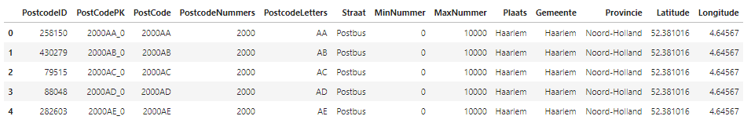
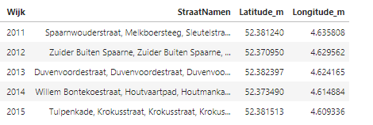
data analysis dataframes
Table. Raw dataset of Haarlem postal code areas with geodata.
Haarlem PC 1 (n = 4257) (Excel©)
Haarlem PC 4 (n = 19) (panda df)
Table. Adapted dataset of Haarlem postal code areas with geodata.
introduction data methodology data analysis results conclusion
Notes:
Raw Haarlem dataset and final working copy with neighborhoods ("Wijk"), list of street names and averaged lattude and longitude.

Slide 7
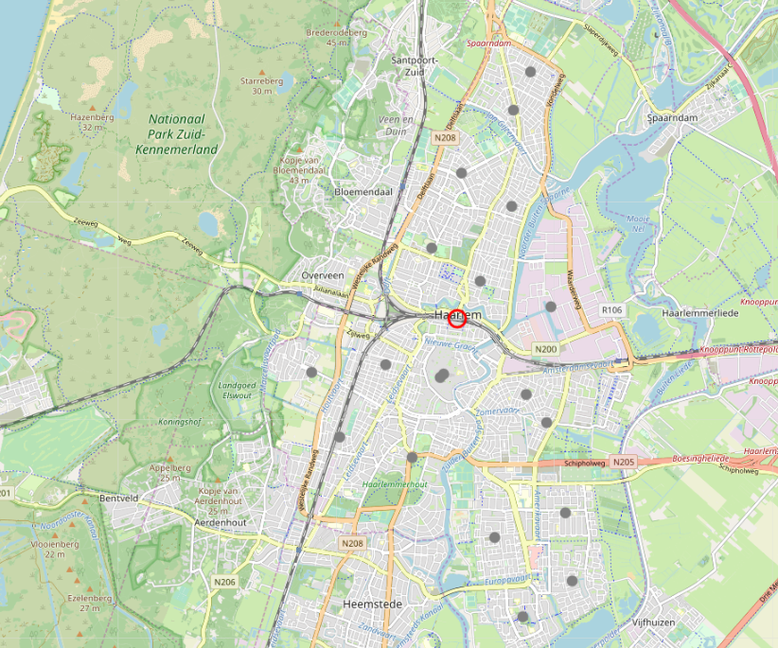
data analysis visualization: neighborhoods
introduction data methodology data analysis results conclusion
Notes:
Haarlem map, centered around Central Station; 19 neighborhoods indicated.

Slide 8
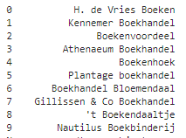
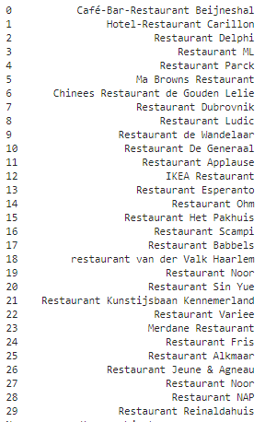
data analysis inventory
introduction data methodology data analysis results conclusion
Notes:
List of available book stores and restaurants in the area.

Slide 9
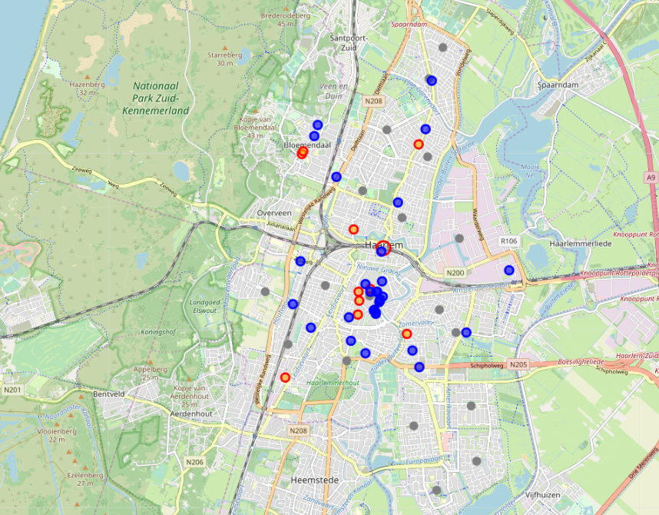
data analysis visualization: book stores & restaurants
introduction data methodology data analysis results conclusion
Notes:
Orange dots: book stores; blue dots: restaurants.

Slide 10
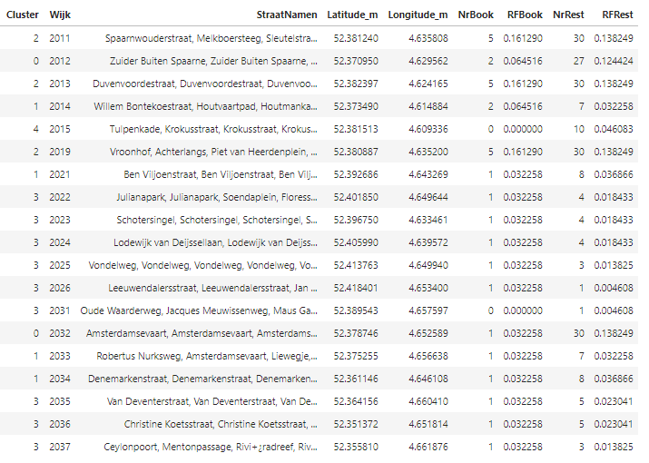
data analysis cluster allocation
Table. Cluster allocation based on relative frequencies of book stores and restaurants present (n=19).
introduction data methodology data analysis results conclusion
Notes:
Cluster allocation of neighborhoods, based on its relative frequencies of book stores and restaurants.

Slide 11
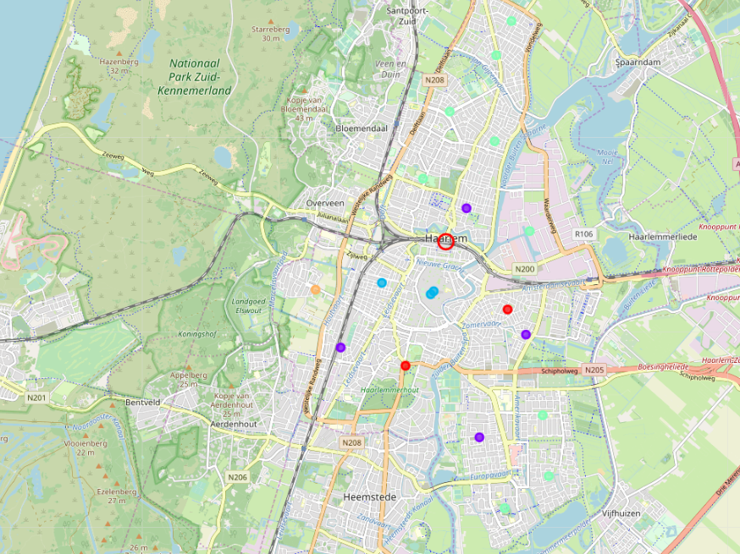
data analysis visualization: cluster neighborhoods
introduction data methodology data analysis results conclusion
Notes:
Five clusters of neighborhoods identified.

Slide 12
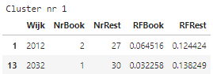
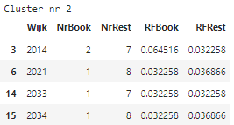
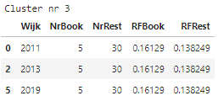
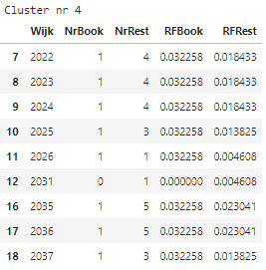
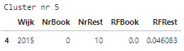
data analysis cluster examination
distance CS: 2002-1410 m
avg distance CS: 927 m
avg distance CS: 2630 m (1025-4182)
introduction data methodology data analysis results conclusion
Notes:
Cluster 3 has most book stores & restaurants. Cluster 1 is interesting because high # of restaurants & still within walking distance of CS.
Cluster 5: only a lot of restaurants. Cluster 4: not impressive and huge distance from CS.

Slide 13
results & discussion
Haarlem: 19 neighborhoods, based on the available Dutch Postal Code system. Book stores and restaurants are not evenly distributed. Most book stores are concentrated in the center of Haarlem, restaurants are widely distributed in the area.
Challenge: to find an optimum spot for the yearly Halewijn Award Ceremony. Criteria formulated: a) a high concentration of book stores and b) many restaurants present in the neighborhood; * preferably within walking distance from Central Station (30 minutes = 2.5 kilometers).
Final result: Five clusters of neighborhoods were identified. Cluster 3: 3 nearby neighborhoods > high # book stores & restaurants (avg dist 927 m) Cluster 1: 2 neighborhoods > few book stores, large # restaurants (avg dist 1706m)
Recommendation: Cluster 3 preferred. Cluster 1 probable location for dining afterwards in a less crowded atmosphere.
introduction data methodology data analysis results conclusion

Slide 14
conclusion
Optimal neighborhoods for the Halewijn Award Ceremony: postal code areas 2011, 2013 and 2019
high numbers of book stores and restaurants present and within walking distance of the Central Station.
Further exploration of neighborhoods 2012 and 2032 however is encouraged, especially if dining after the ceremony in a quiet surrounding is desired.
On spot visualization of these neighborhoods is suggested, in order to make a reasonable choice for the forthcoming location of the Halewijn Award ceremony in Haarlem.
introduction data methodology data analysis results conclusion

Slide 15

questions?

